Slide 1
Abstract Expressionism

Slide 2
Abstract Expressionism
A post–World War II art movement in American painting that developed in New York in the 1940s. The movement was characterized by art that does not depict objective reality, but rather a subjective expression of inner experience. This inner experience was intended to strike emotional chords with viewers.

Slide 3
Abstraction
Things that do not exist in the world and also things that exist but are not treated as they are normally treated in proper context.

Slide 4
Representational Abstraction
Images that are recognizable but out of their proper context. Think of artists like Picasso.

Slide 5
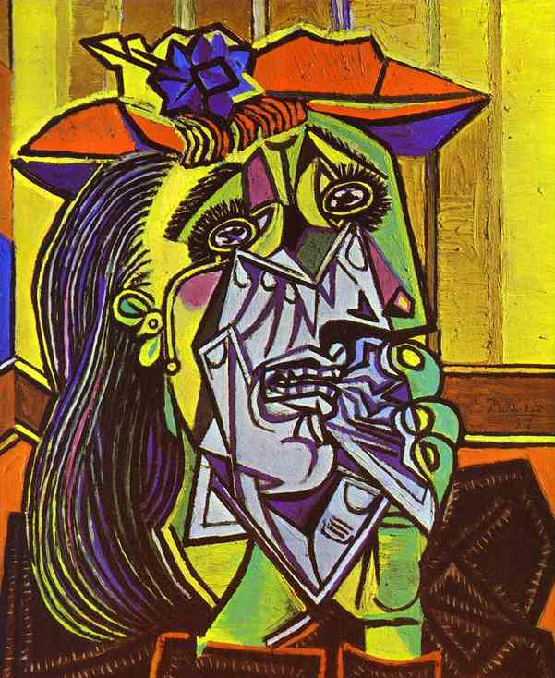

Slide 6
Nonrepresentational/Nonobjective Abstraction
A type of abstraction not intended to represent reality. Essentially, the artwork does not represent or depict a person, place or thing in the natural world. Usually, the content of the work is its color, shapes, brushstrokes, size, scale, and, in some cases, its process. Generally nonrepresentational abstraction involves a subjective expression of inner experience.

Slide 7
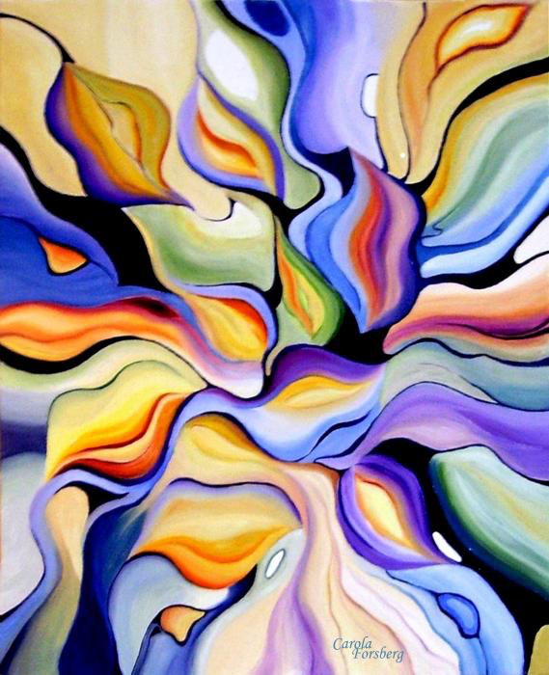

Slide 8
Gestural Abstraction/Action Painting
A type of abstraction that emphasizes the process of making art and where the artist’s actions are clear. This often happens through a variety of techniques that include dripping, dabbing, smearing, and even flinging paint on to the surface of the canvas.

Slide 9
Horizontality
When paintings were made on the ground instead of an easel. Think of artists like Jackson Pollock.

Slide 10
All-Over Painting
Making sure that no one part of a painting is more important than another, a method to create flatness and no depth.

Slide 11
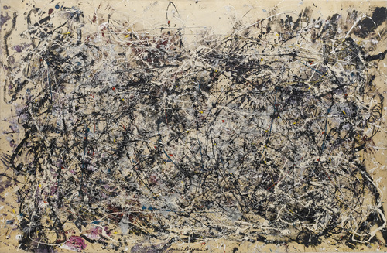

Slide 12
Pentimenti
Where you can see evidence of the previous marks made by the artist underneath the final image, similar to erasure or painting over.

Slide 13
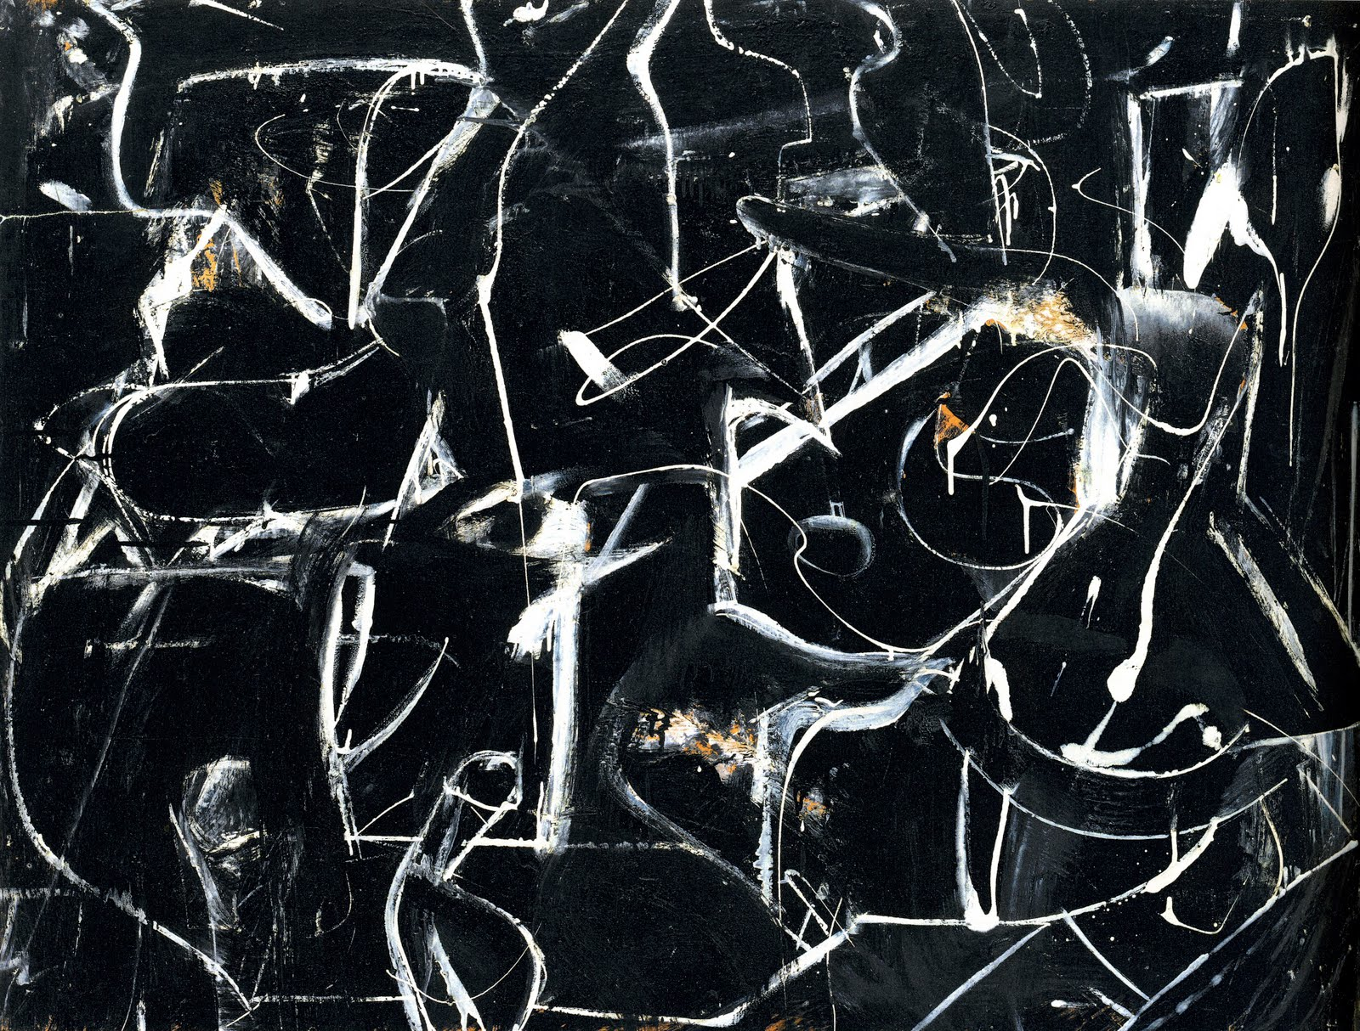

Slide 14
Chromatic Abstraction
Where color becomes the gesture.

Slide 15
Color Field
Color field is characterized primarily by large fields of flat, solid color spread across or stained into the canvas creating areas of unbroken surface and a flat picture plane. In color field painting color is freed from objective context and becomes the subject itself.

Slide 17
The Monochrome
When only one color is utilized in a painting and its values are explored on a single surface.

Slide 19
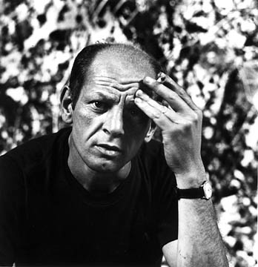
Jackson Pollock

Slide 20
Jackson Pollock – No. 1 – 1948 – Oil and enamel

Slide 21
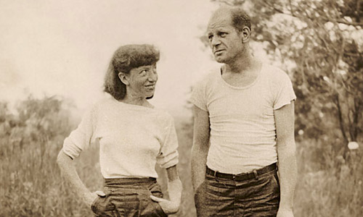

Slide 22
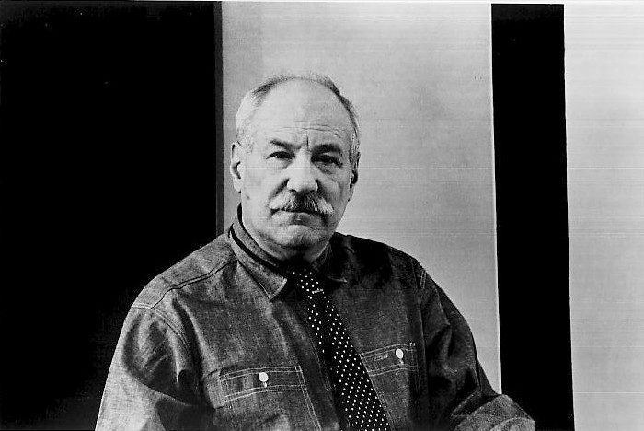
Barnett Newman

Slide 23
Barnett Newman – Vir heroicus sublimis – 1950 – 1951 – Oil

Slide 24
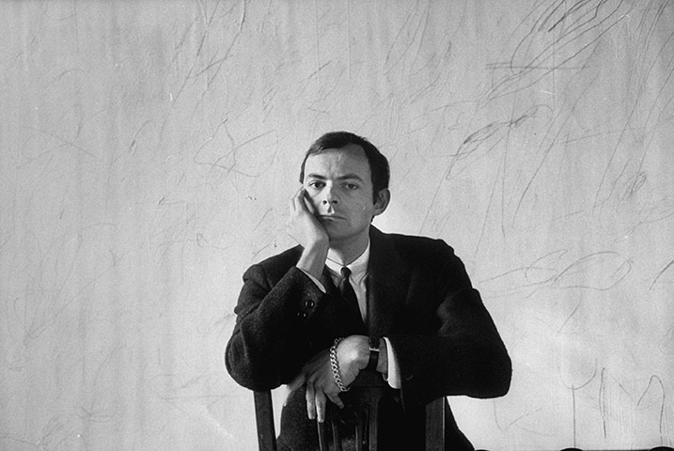
Cy Twombly

Slide 25
Cy Twombly – Free Wheeler – 1955 –
Paint, crayon, pencil, & pastel

Slide 26
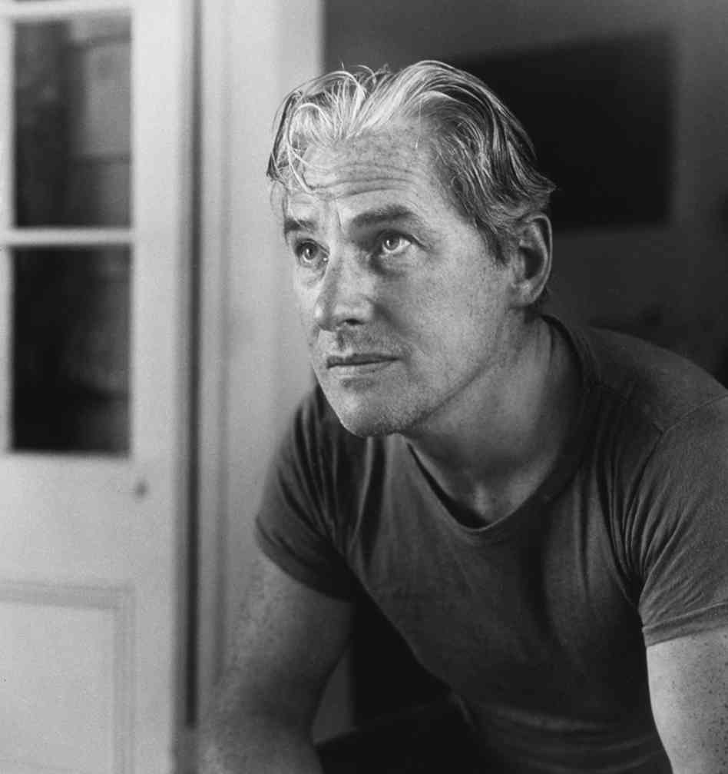
Willem de Kooning

Slide 27
Willem de Kooning – Untitled – 1948 – Oil, enamel, and paper

Slide 28
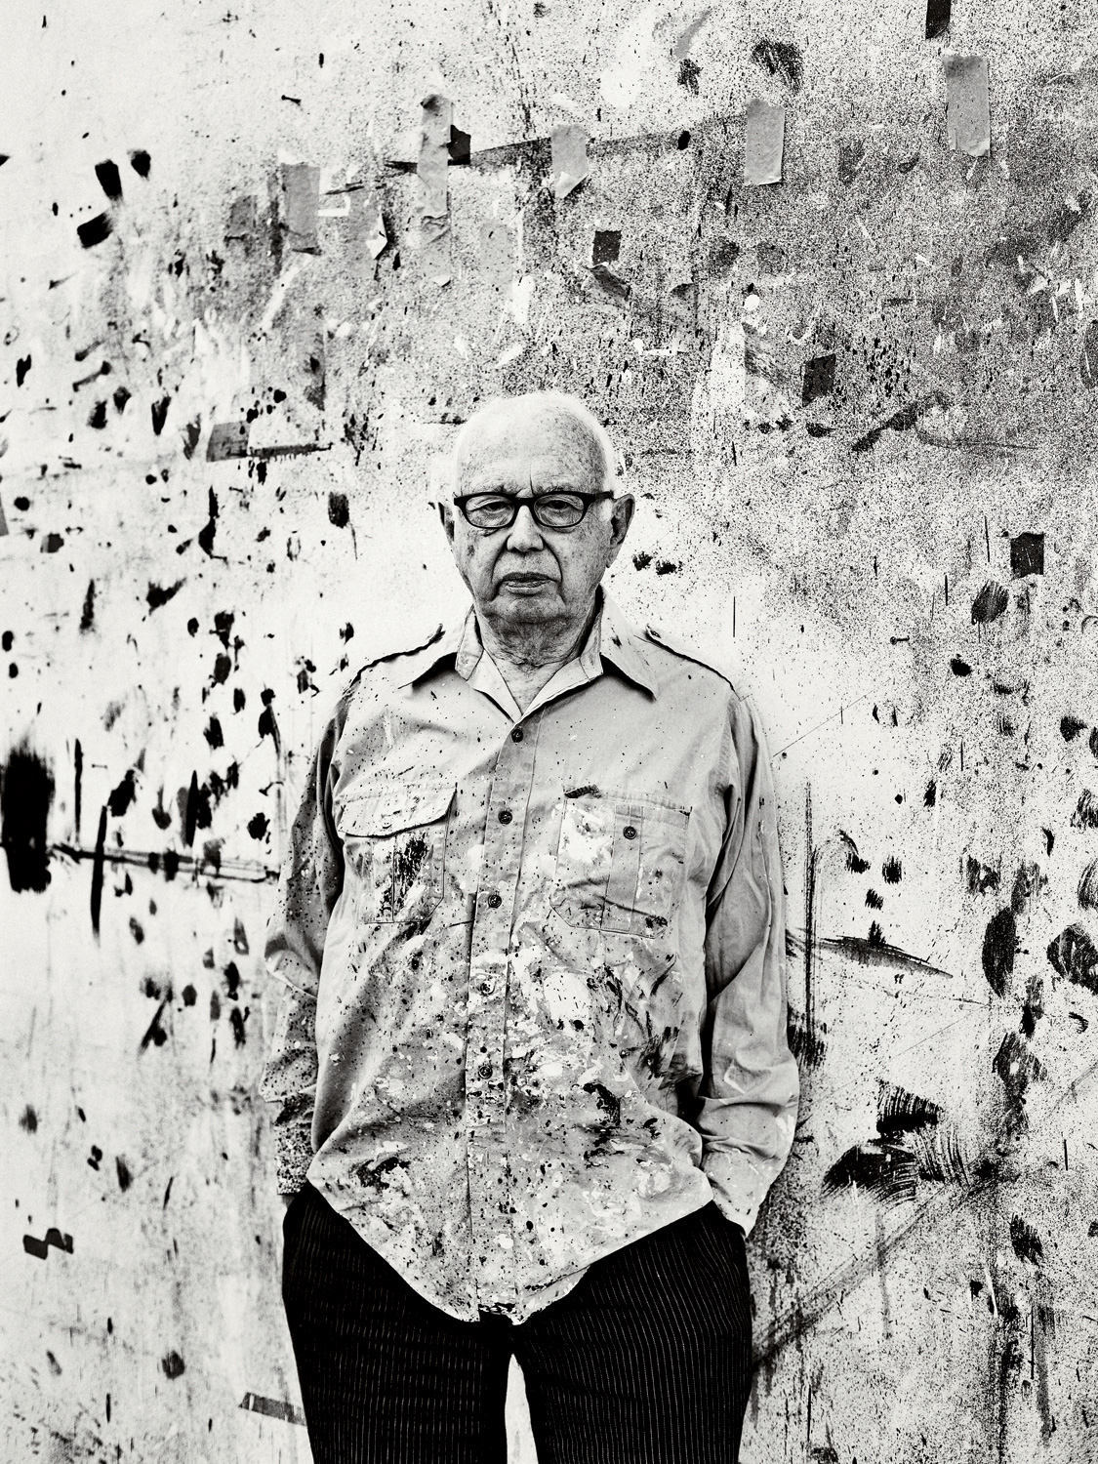
Ellsworth Kelly

Slide 29
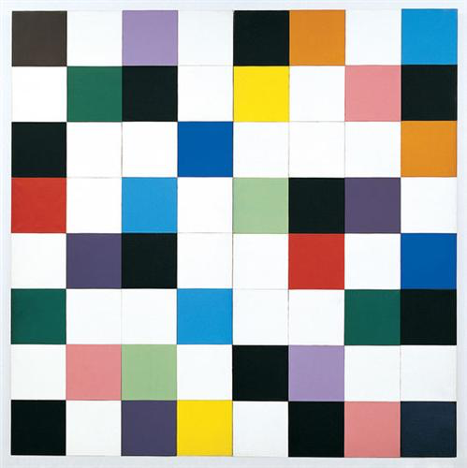
Ellsworth Kelly – Colors for a Large Wall – 1951 - Oil

Slide 30
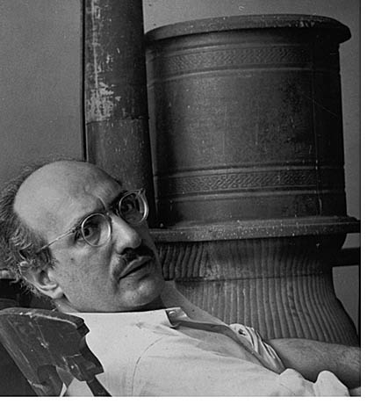
Mark Rothko

Slide 31
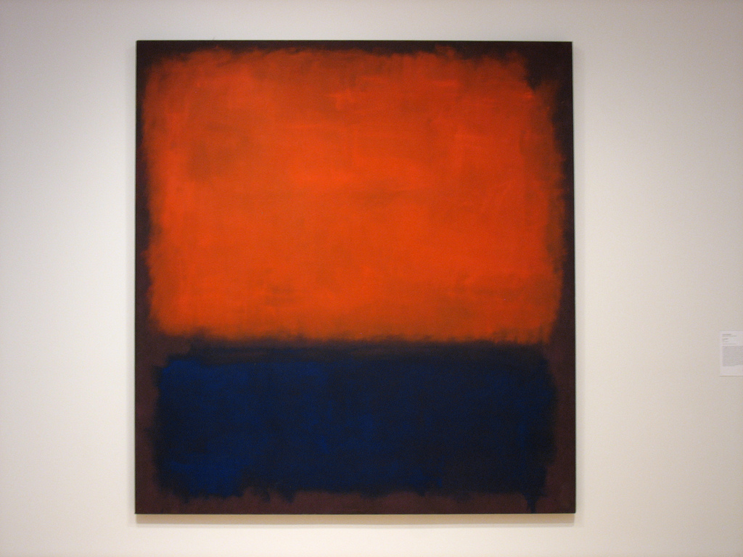
Mark Rothko – No. 14 – 1960 – Oil

