Slide 1
African and Oceanic Art

Slide 2
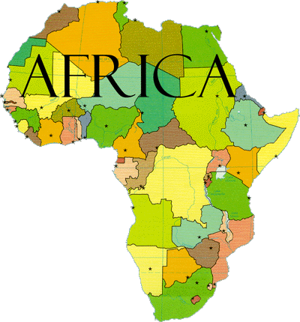

Slide 3
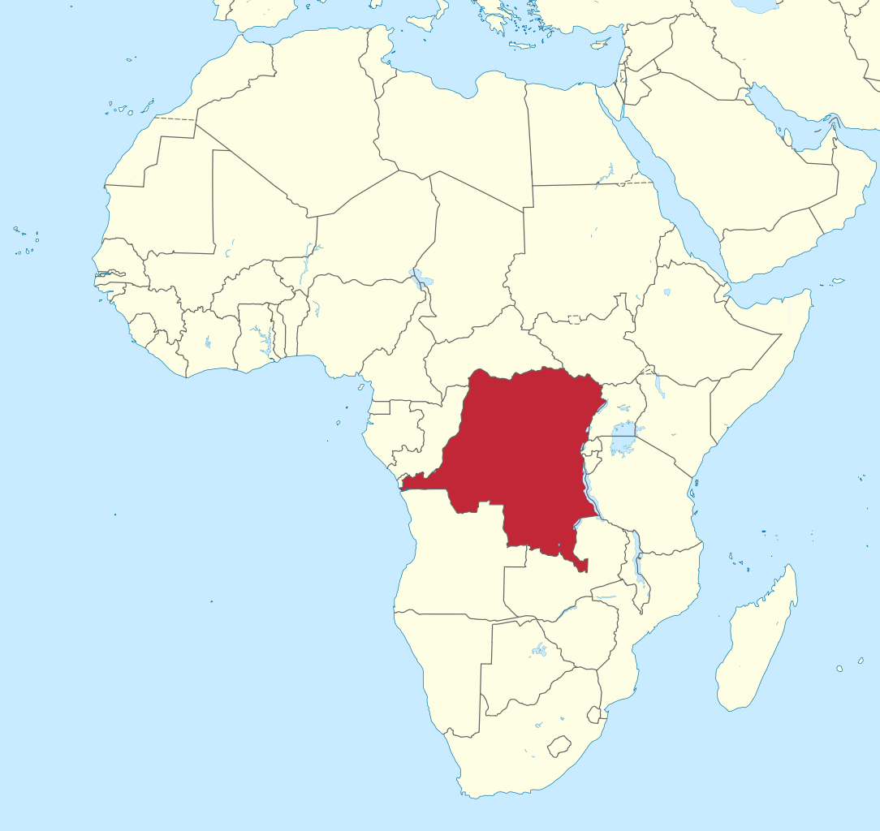
DEMOCRATIC REPUBLIC OF CONGO

Slide 4
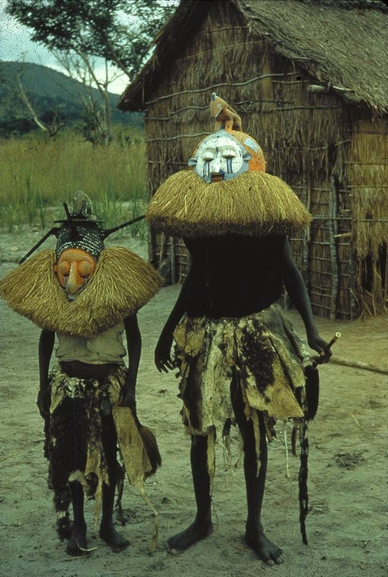
1
Title: A masked Instructor and one of his students during an initiation ceremony
Material/Medium: Photograph
Location/Culture: Pende (Democratic Republic of Congo)
Date: 20th century

Slide 5
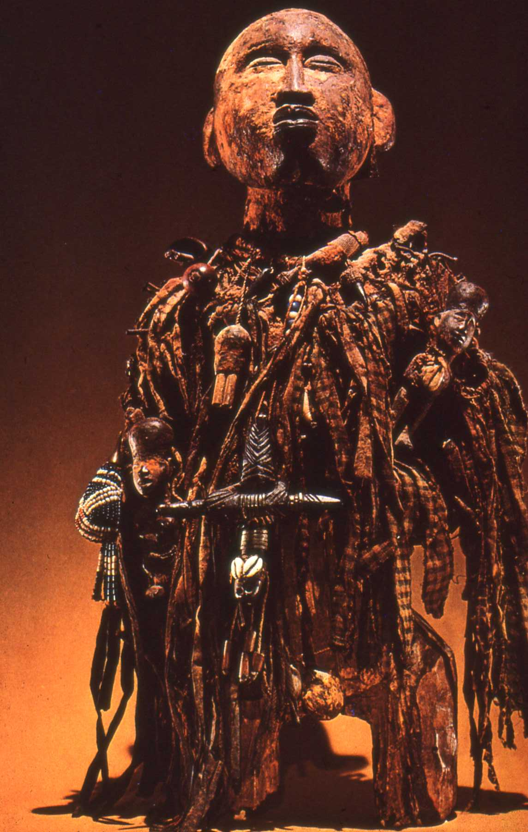
2
Title: Power figure
Material: Mixed media Culture: Kongo (Democratic Republic of Congo) Date: 20th century

Slide 6
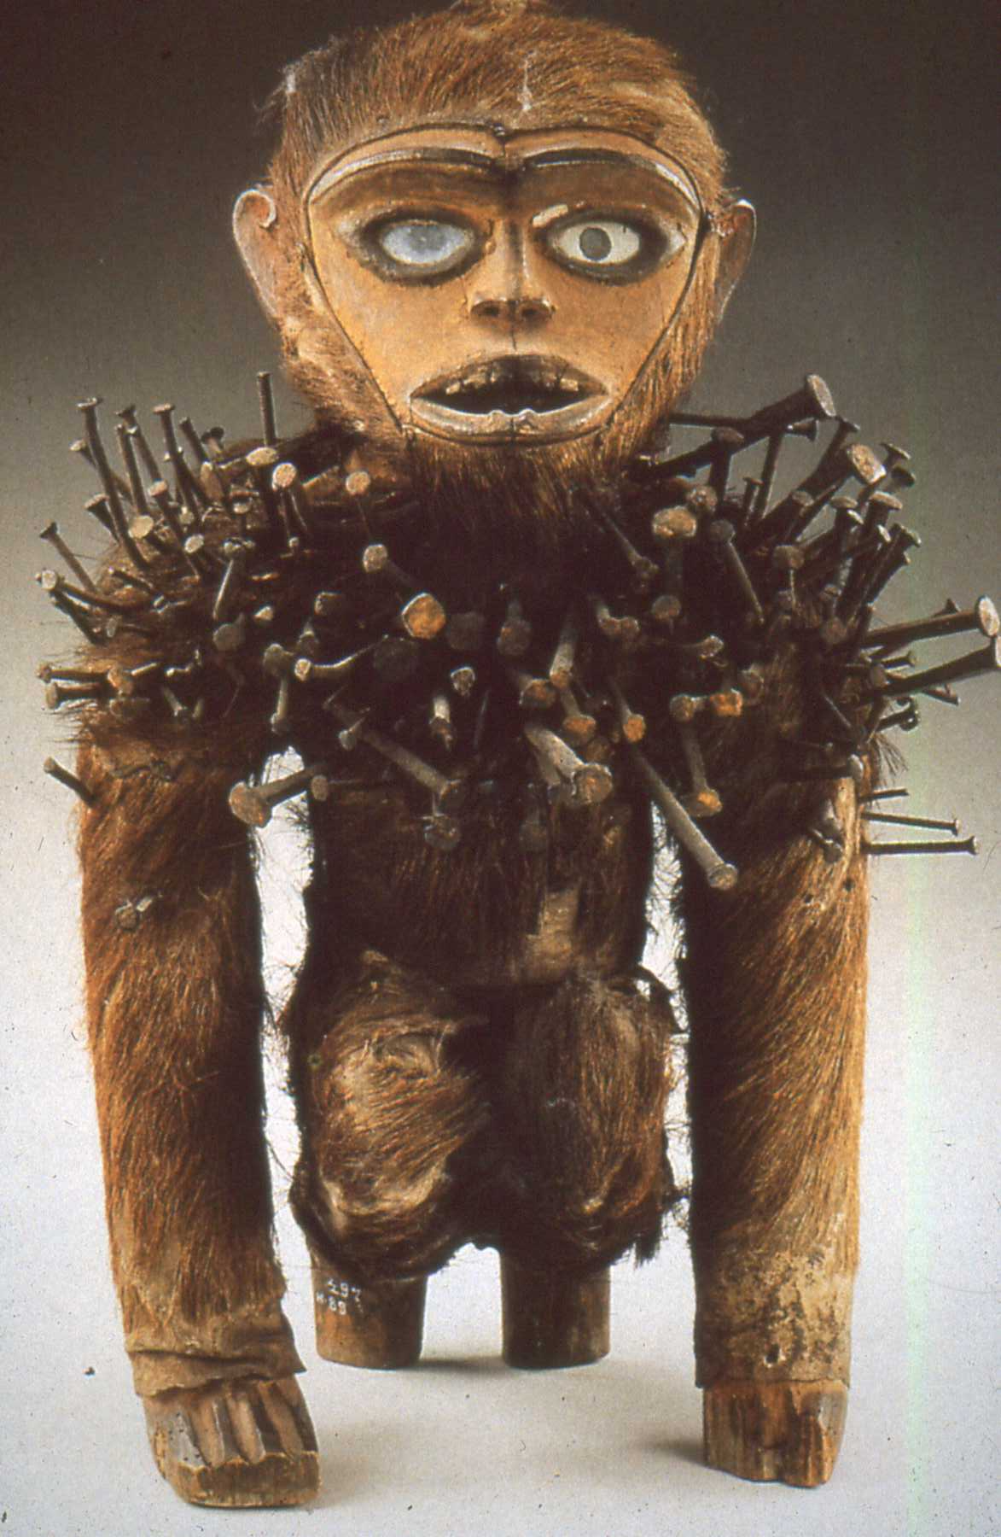
3
Title: “Monkey” Power Figure with nails Material: Mixed media Culture: Kongo (Democratic Republic of Congo)
Date: 20th century

Slide 7
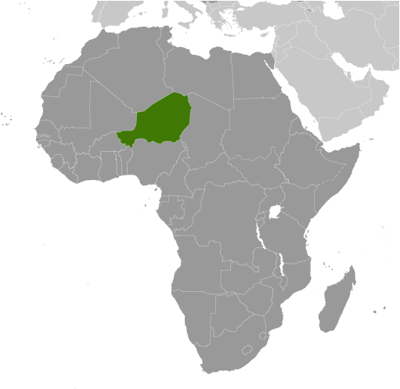
NIGER REPUBLIC

Slide 8
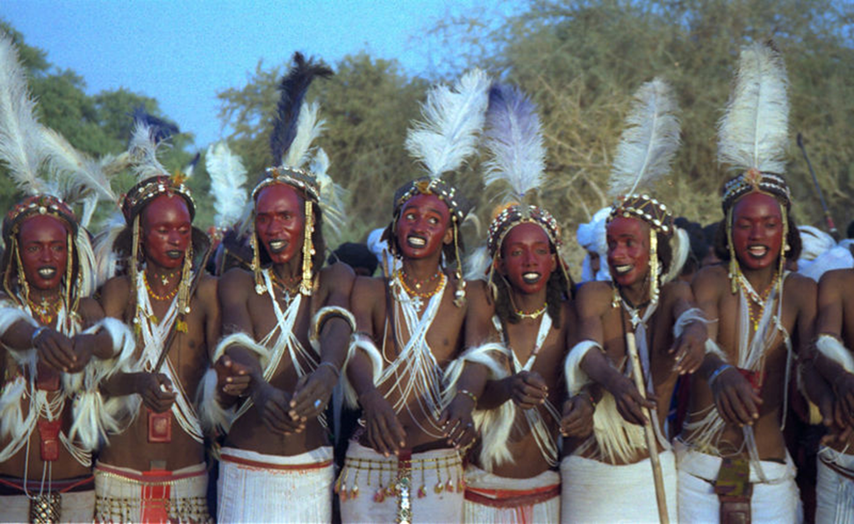
Title: Bachelors performing the YANKE dance to attract women during the GEREWOL festival.
Material/Medium: Photograph
Culture: Wodaabe (Niger Republic)
Date: 1990s 4

Slide 9
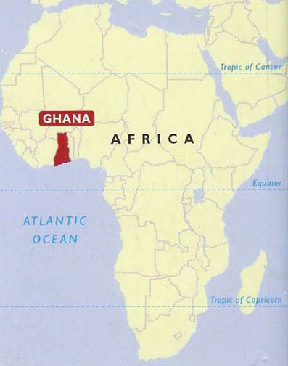

Slide 10
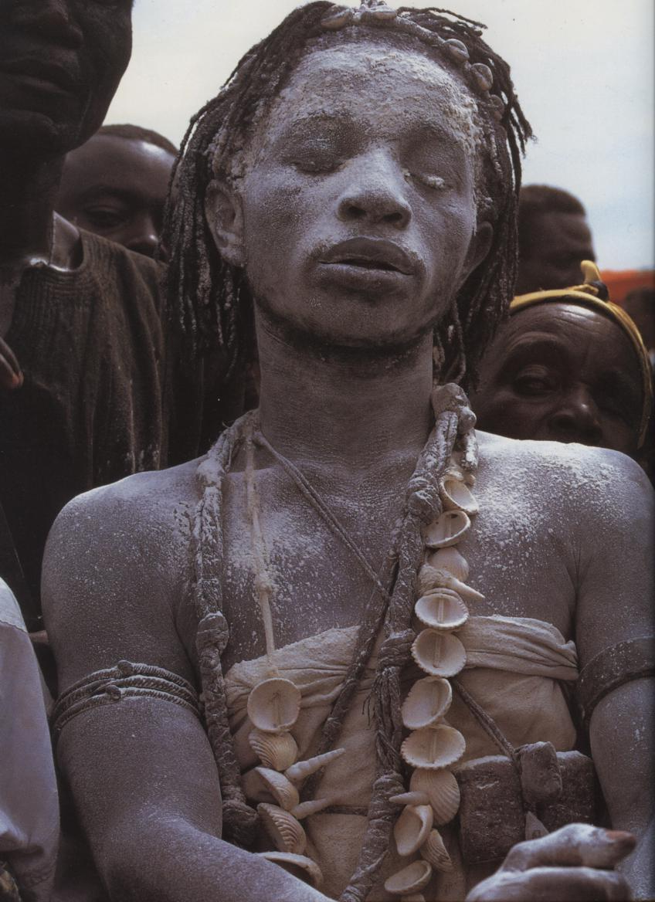
5
Title: A Spirit Medium
Material/Medium: Photograph
Location/Culture: Asante (Ghana)
Date: 1970s

Slide 11
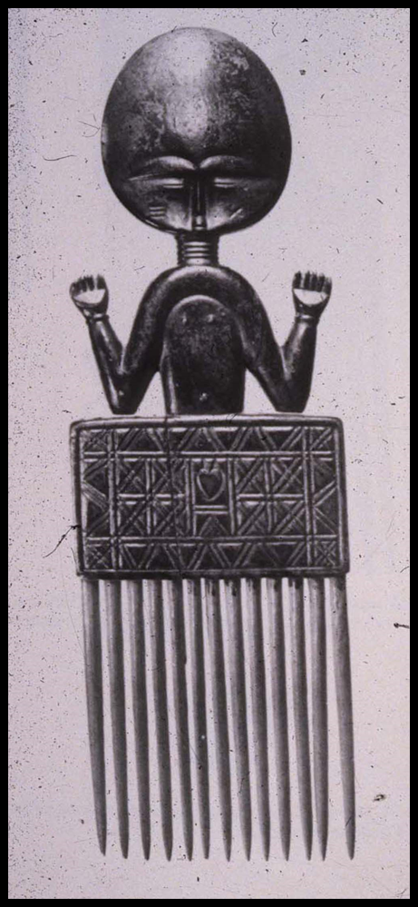
6
Title: Akuaba Comb
Culture: Asante (Ghana, West Africa)
Material: Wood, beads)
Date: 20th century

Slide 12
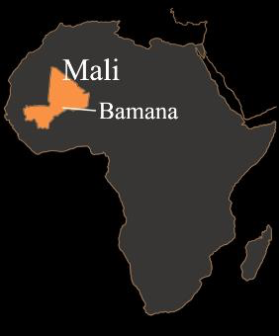

Slide 13
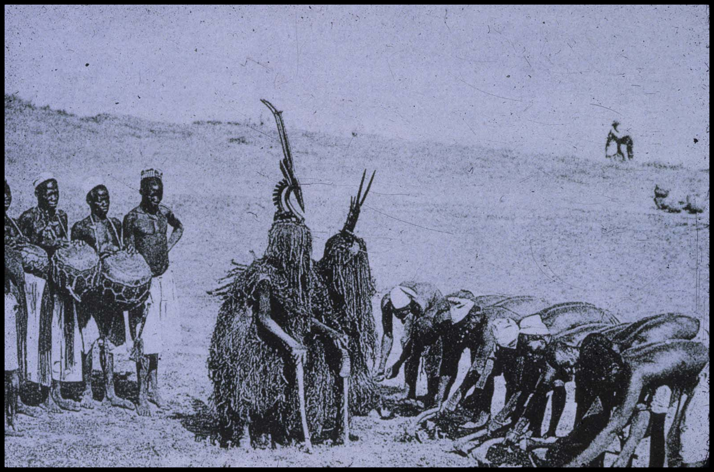
Title: Two Chi Wara Masks Performing during an agricultural ritual
Culture: Bamana (Mali)
Material: Photograph
Date: 20th century
7

Slide 14
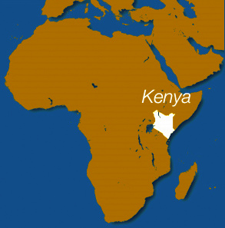

Slide 15
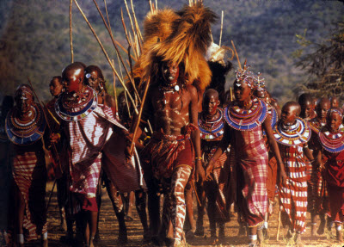
Title: Warrior (IL-MORANI) wearing a “lion-mane” headdress indicating that he had killed a lion
Material/Medium: Photograph
Location/Culture: Maasai (Kenya)
Date: 20th century
8

Slide 16
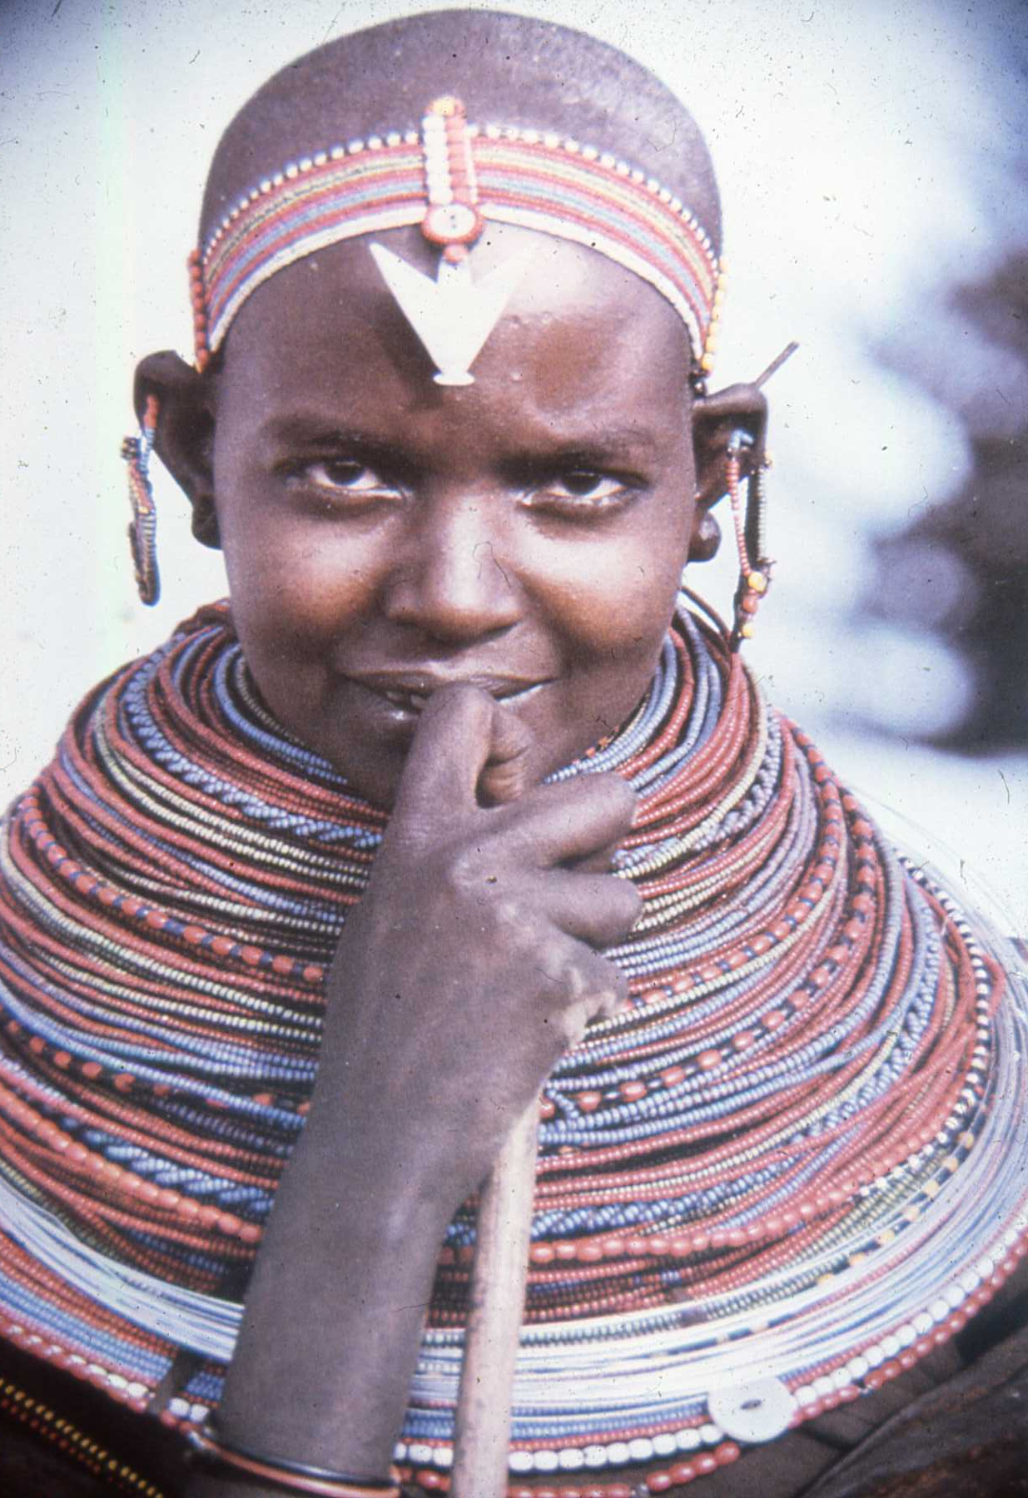
9
Title: Maiden with loose and assorted
beaded necklaces
Material: Photograph Culture: Samburu (Kenya)
Date: 20th century

Slide 17
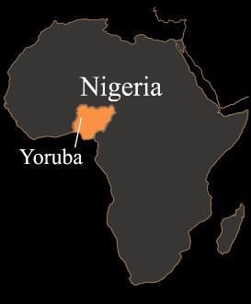

Slide 18
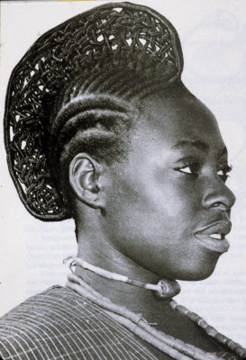
10
Title: Bride with elaborate hairdo
Material/Medium: Photograph
Location/Culture: Yoruba (Nigeria)
Date: 20th century

Slide 19
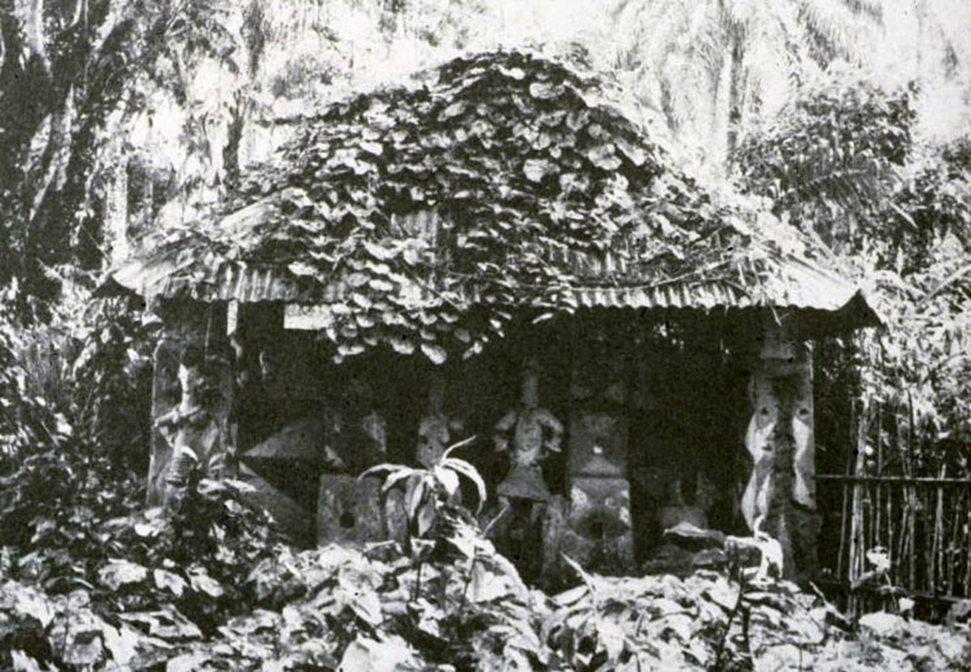
Title: Abandoned Mbari house Material: Mixed media Culture: Igbo (Nigeria)
Date: Photograph taken in the 1960s
11

Slide 20
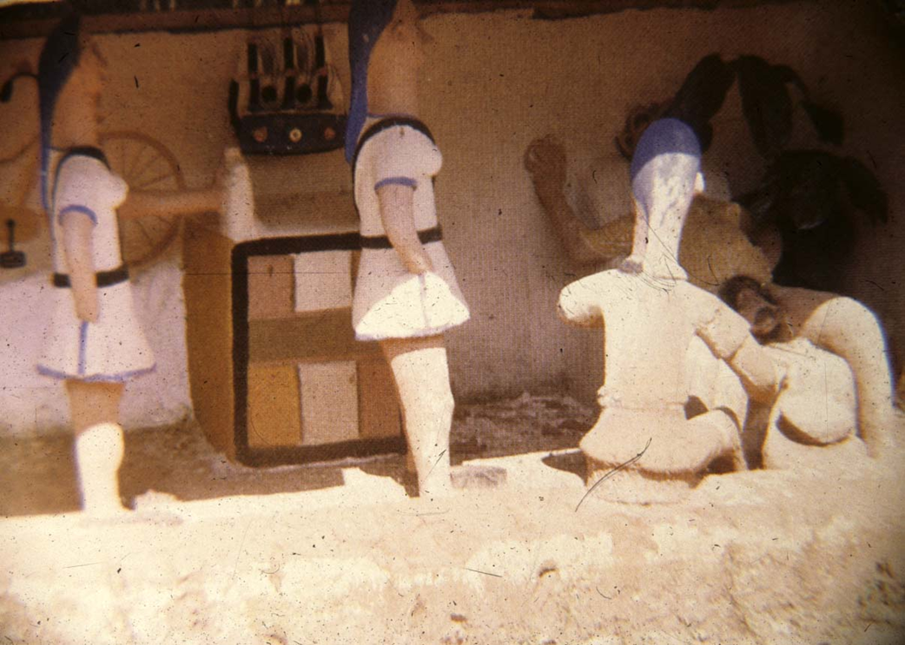
Title: Mbari Sculpture Depicting Nurses in a Labor Room
Material: Clay, metal, wood, paint
Culture: Igbo (Nigeria)
Date: Photograph taken in the 1960s
12

Slide 21
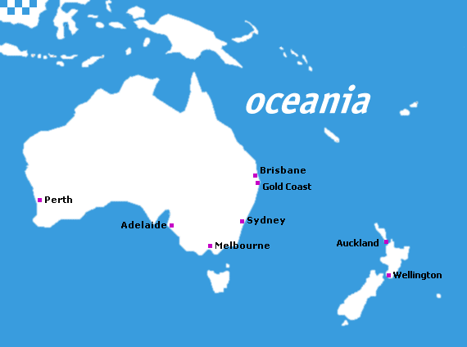

Slide 22
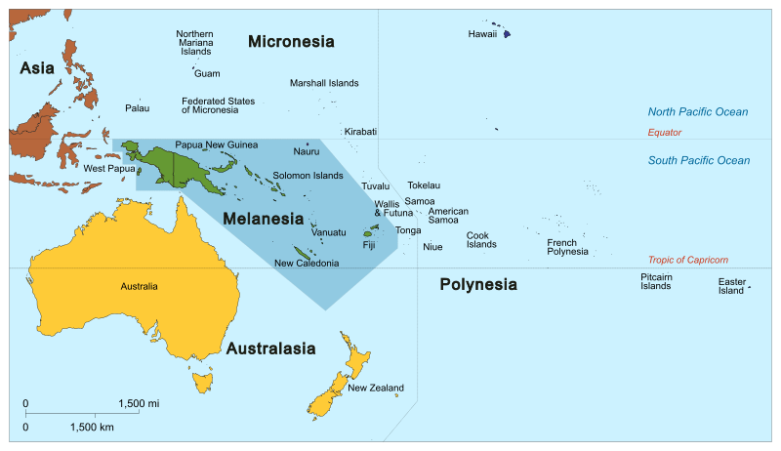

Slide 23
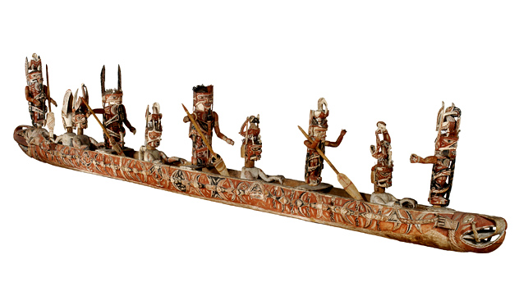
13
Title: Malanggan spirit canoe with ten ancestor figures
Country: Northern New Ireland (Melanesia)
Medium: Mixed media
Date: 20th century

Slide 24
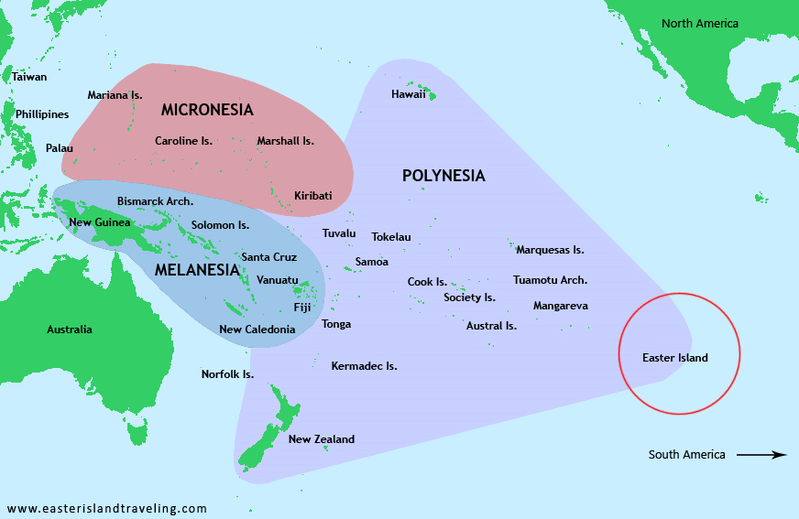

Slide 25
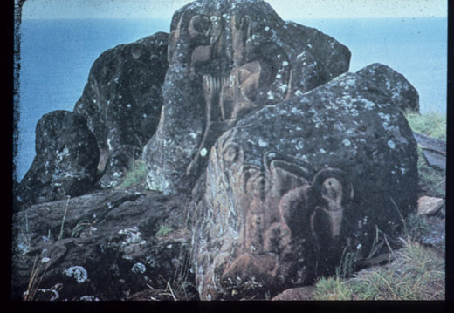
Title: Carved rock signifying Creator Deity (Make-make)
Country: Easter Island (Eastern Polynesia)
Medium: Volcanic rock
Date: Pre-20th century
14

Slide 26
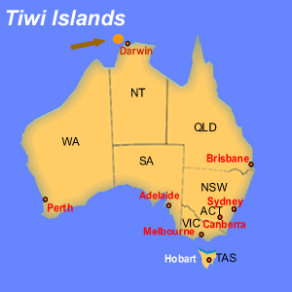

Slide 27
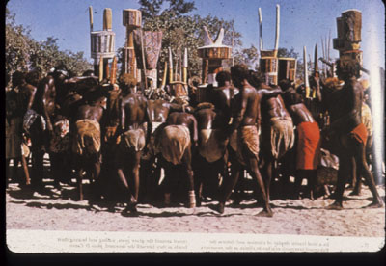
Title: Mourners during a Pukamuni ceremony
Culture/Country: Tiwi Islands (Australia)
Medium: Photograph
Date: 1960's
15

Slide 28
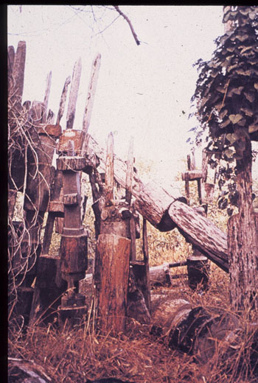
16
Title: Abandoned pukamuni poles
Culture/Country: Tiwi Islands (Australia)
Medium: Photographs
Date: 1960's

Slide 29
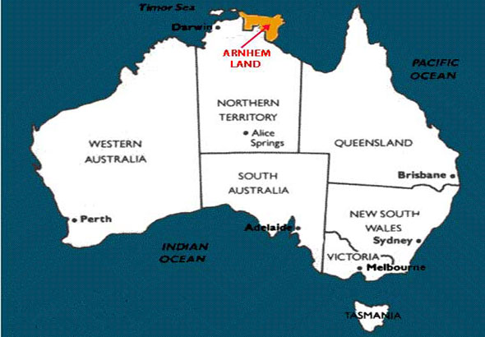

Slide 30
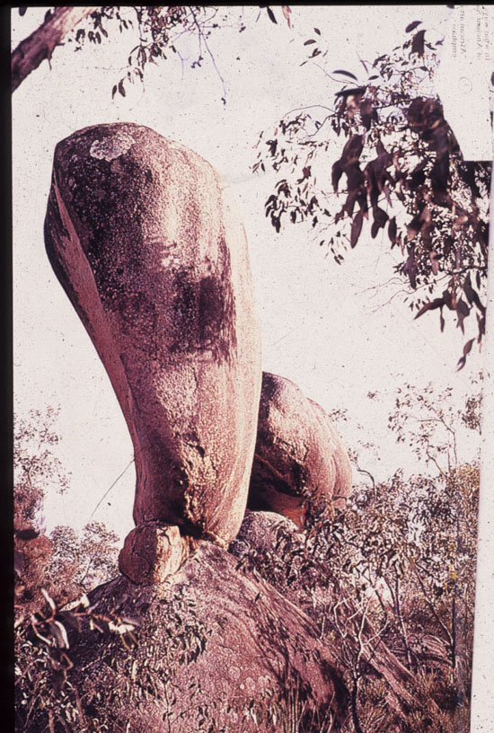
17
Title: Rock formation associated with “Dreamtime” ancestors
Culture/Country: Arnhem Land (Australia)
Medium: Photograph
Date: 20th century

Slide 31
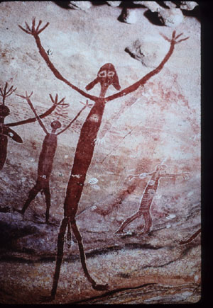
18
Title: “Mimi” spirits with raised arms
Culture/Country: Arnhem Land (Australia)
Medium: Rock, pigment
Date: Unknown (Prehistoric).

Slide 32
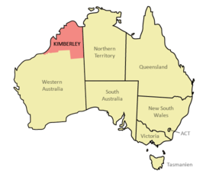

Slide 33
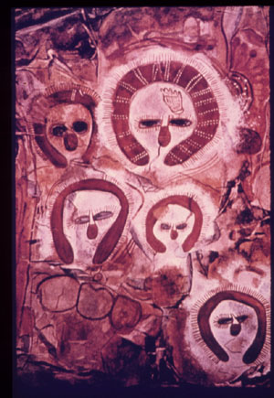
19
Title: Wandjina spirits
Culture/Country: Kimberly (Australia)
Medium: Rock, pigment
Date: Prehistoric art, repainted in the 20th century.

Slide 34
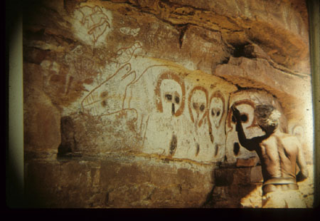
20
Title: Charlie restoring a Wondjina painting at Mamadai
Culture/Country: Kimberly (Australia)
Medium: Photograph
Date: 1960's

